Slide 1

INFORMATION SYSTEM
UNIT 04: ORGANIZATION OF INFORMATION WITH DATABASE
© 2019, PRAMOD PARAJULI

Slide 2
Disclaimer
These slides are part of teaching materials for Information System (IS). These slides do not cover all aspect of learning IS, nor are these to be taken as primary source of information. As the core textbooks and reference books for learning the subject has already been specified and provided to the students, students are encouraged to learn from the original sources.
Contents in these slides are copyrighted to the instructor and authors of original texts where applicable.

Slide 3
Organization of information with database
4.1 Database design process and the relational database model
4.2 DDL, DML, normalization, rules for 2NF & 3NF
4.3 E-R Models
4.4 Physical database design concepts, de-normalization, file organization, indexing

Slide 4
Structuring System Data Requirements
References - - - - - - - - Valacich and George, Modern Systems Analysis and Design, 8th Ed., Pearson, Chapter 8

Slide 5
Learning Objectives
Concisely define each of the following key data modeling terms: entity type, attribute, multivalued attribute, relationship, degree, cardinality, business rule, associative entity, trigger, super-type, sub-type.
Draw an entity-relationship (E-R) diagram to represent common business situations.
Explain the role of conceptual data modeling in the overall analysis and design of an information system.

Slide 6
Learning Objectives (Cont.)
Explain the role of prepackaged database models (patterns) in data modeling.
Distinguish between unary, binary, and ternary relationships and give an example of each.
Define four basic types of business rules in a conceptual data model.
Relate data modeling to process and logic modeling as different views of describing an information system.

Slide 7
Conceptual Data Modeling
Conceptual data modeling: a detailed model that captures the overall structure of data in an organization
Independent of any database management system (DBMS) or other implementation considerations

Slide 8
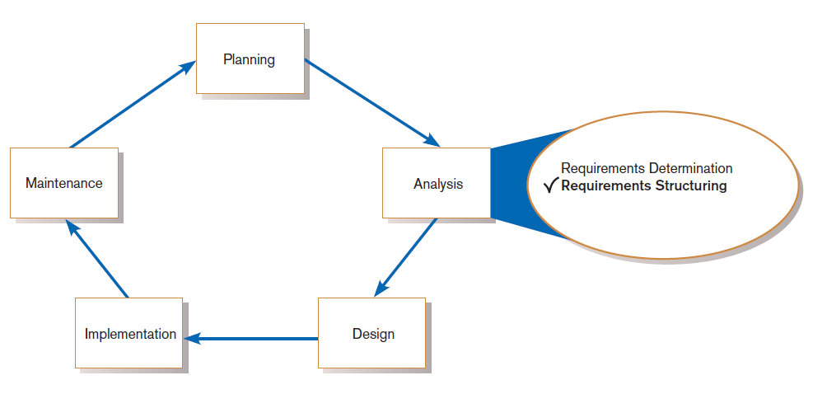
Conceptual Data Modeling (Cont.)
FIGURE 8-1
Systems development life cycle with analysis phase highlighted

Slide 9
The Conceptual Data Modeling Process
Develop a data model for the current system.
Develop a new conceptual data model that includes all requirements of the new system.
In the design stage, the conceptual data model is translated into a physical design.
Project repository links all design and data modeling steps performed during SDLC.

Slide 10
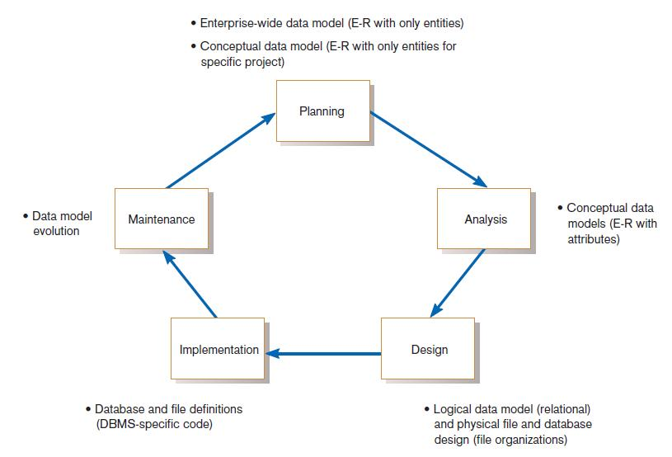
Conceptual Data Modeling (Cont.)
FIGURE 8-2
Relationship between data modeling and the SDLC

Slide 11
Deliverables and Outcome
Entity-relationship (E-R) diagram or UML class diagram
Entities (or classes) – categories of data, represented as rectangles
Relationships (or associations) – lines between the entities
Set of entries about data objects to be stored in repository project dictionary, or data modeling software
Repository links data, process, and logic models of an information system.
Data elements included in the data flow diagram (DFD) must appear in the data model and vice versa.
Each data store in a process model must relate to business objects represented in the data model.

Slide 12
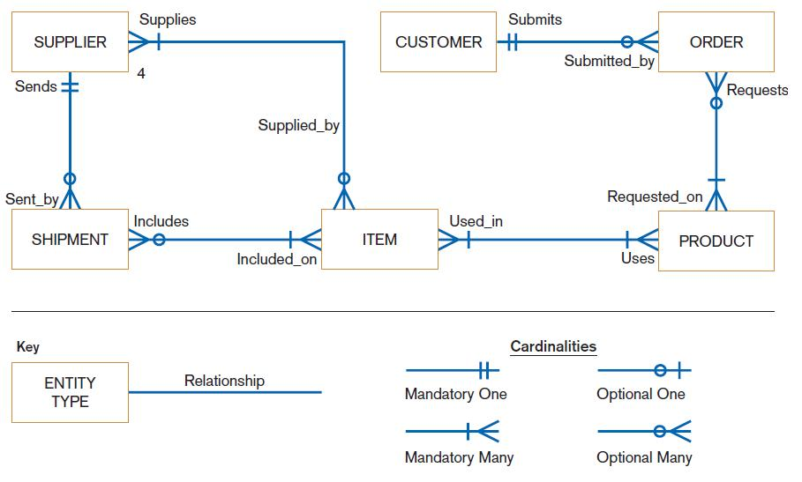
FIGURE 8-3
Sample conceptual data model

Slide 13
Gathering Information for Conceptual Data Modeling
Two perspectives on data modeling:
Top-down approach for a data model is derived from an intimate understanding of the business.
Bottom-up approach for a data model is derived by reviewing specifications and business documents.

Slide 14
Gathering Information for Conceptual Data Modeling (Cont.)
Requirements Determination Questions for Data Modeling:
What are subjects/objects of the business?
Data entities and descriptions
What unique characteristics distinguish between subjects/objects of the same type?
Primary keys

Slide 15
Gathering Information for Conceptual Data Modeling (Cont.)
What characteristics describe each subject/object?
Attributes and secondary keys
How do you use the data?
Security controls and user access privileges
Over what period of time are you interested in the data?
Cardinality and time dimensions

Slide 16
Gathering Information for Conceptual Data Modeling (Cont.)
Are all instances of each object the same?
Supertypes, subtypes, and aggregations
What events occur that imply associations between objects?
Relationships and cardinalities
Are there special circumstances that affect the way events are handled?
Integrity rules, cardinalities, time dimensions

Slide 17
Introduction to Entity-Relationship (E-R) Modeling
Entity-Relationship data model (E-R model): a detailed, logical representation of the entities, associations and data elements for an organization or business area
Entity-relationship diagram (E-R diagram): a graphical representation of an E-R model

Slide 18
Introduction to Entity-Relationship (E-R) Modeling
The E-R model is expressed in terms of:
Data entities in the business environment.
Relationships or associations among those entities.
Attributes or properties of both the entities and their relationships.

Slide 19
Introduction to E-R Modeling (Cont.)
Entity: a person, place, object, event or concept in the user environment about which data is to be maintained
Entity type: collection of entities that share common properties or characteristics
Entity instance: single occurrence of an entity type

Slide 20
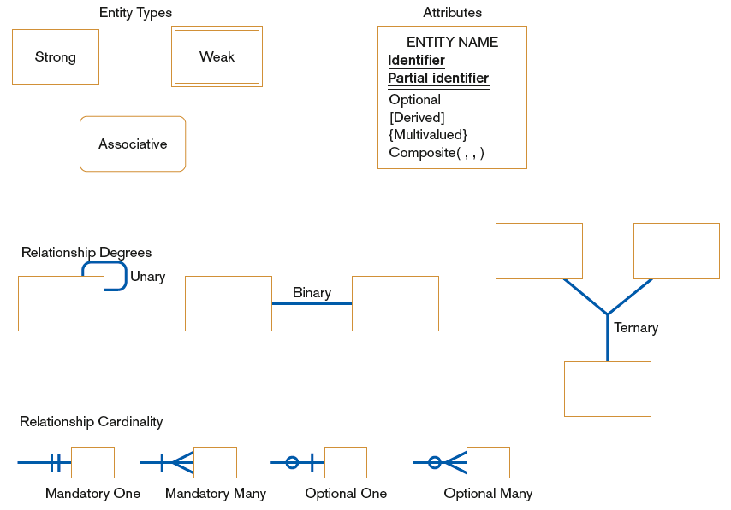
FIGURE 8-5 Basic E-R notation

Slide 21
Naming and Defining Entity Types
An entity type name should be:
A singular noun.
Descriptive and specific to the organization.
Concise.
Event entity type should be named for the result of the event, not the activity or process of the event.

Slide 22
Naming and Defining Entity Types (Cont.)
An entity type definition:
Includes a statement of what the unique characteristic(s) is (are) for each instance.
Makes clear what entity instances are included and not included in the entity type.
Often includes a description of when an instance of the entity type is created or deleted.

Slide 23
Naming and Defining Entity Types (Cont.)
For some entity types the definition must specify:
When an instance might change into an instance of another entity type.
What history is to be kept about entity instances.

Slide 24
Attributes
Attribute: a named property or characteristic of an entity that is of interest to the organization
Naming an attribute: i.e. Vehicle_ID
Place its name inside the rectangle for the associated entity in the E-R diagram.

Slide 25
Naming and Defining Attributes
An attribute name is a noun and should be unique.
To make an attribute name unique and for clarity, each attribute name should follow a standard format.
Similar attributes of different entity types should use similar but distinguishing names.

Slide 26
Naming and Defining Attributes (Cont.)
An attribute definition:
States what the attribute is and possibly why it is important.
Should make it clear what is included and what is not included.
Contains any aliases or alternative names.
States the source of values for the attribute.

Slide 27
Naming and Defining Attributes (Cont.)
An attribute definition should indicate:
If a value for the attribute is required or optional.
If a value for the attribute may change.
Any relationships that attribute has with other attributes.

Slide 28
Candidate Keys and Identifiers.
Candidate key: an attribute (or combination of attributes) that uniquely identifies each instance of an entity type
Identifier: a candidate key that has been selected as the unique, identifying characteristic for an entity type

Slide 29
Candidate Keys and Identifiers (Cont.)
Selection rules for an identifier
Choose a candidate key that will not change its value.
Choose a candidate key that will never be null.
Avoid using intelligent keys.
Consider substituting single value surrogate keys for large composite keys.

Slide 30
Other Attribute Types
Multivalued attribute: an attribute that may take on more than one value for each entity instance
Repeating group: a set of two or more multivalued attributes that are logically related

Slide 31
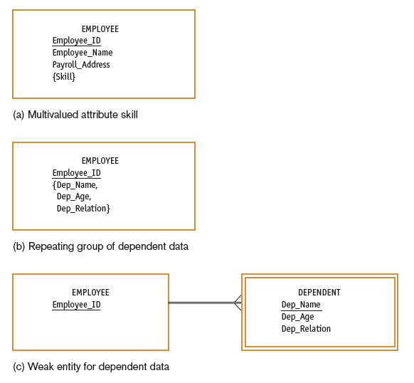
FIGURE 8-8
Multivalued attributes
and repeating groups

Slide 32
Other Attribute Types
Required attribute: an attribute that must have a value for every entity instance
Optional attribute: an attribute that may not have a value for every entity instance
Composite attribute: an attribute that has meaningful component parts
Derived attribute: an attribute whose value can be computed from related attribute values

Slide 33
Relationships
Relationship: an association between the instances of one or more entity types that is of interest to the organization
Degree: the number of entity types that participate in a relationship

Slide 34
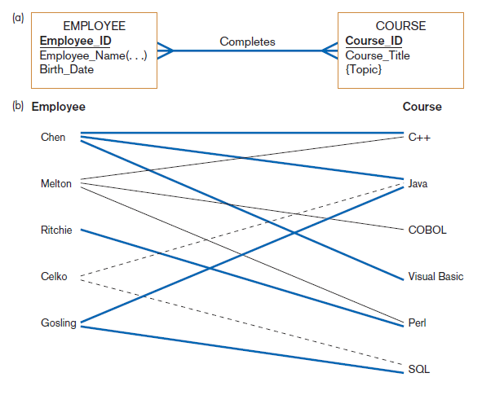
Figure 8-10
Relationship type and instances
(a) Relationship type (Completes)
(b) Relationship instances

Slide 35
Conceptual Data Modeling and the E-R Model
Unary relationship: a relationship between the instances of one entity type
Also called a recursive relationship
Binary relationship: a relationship between instances of two entity types
Most common type of relationship encountered in data modeling
Ternary relationship: a simultaneous relationship among instances of three entity types

Slide 36
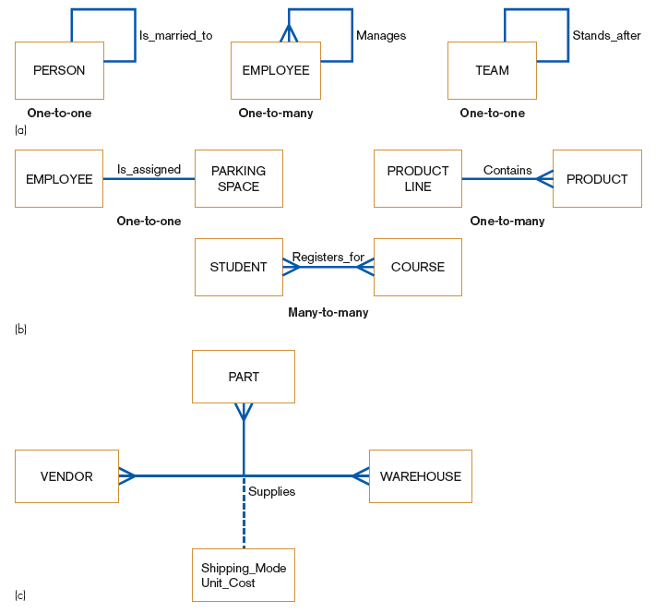
Unary relationships
FIGURE 8-11
Examples of relationships
of different degrees
Binary relationships
Ternary relationships

Slide 37
Cardinalities in Relationships
Cardinality: the number of instances of entity B that can (or must) be associated with each instance of entity A
Minimum Cardinality
The minimum number of instances of entity B that may be associated with each instance of entity A
Maximum Cardinality
The maximum number of instances of entity B that may be associated with each instance of entity A

Slide 38
Cardinalities in Relationships (Cont.)
Mandatory vs. Optional Cardinalities
Specifies whether an instance must exist or can be absent in the relationship

Slide 39
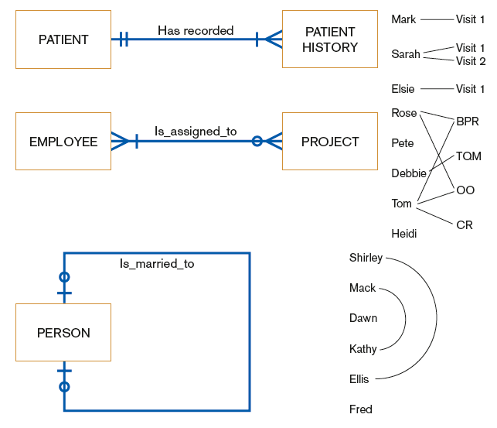
FIGURE 8-14 Examples of cardinality constraints
(a) Mandatory cardinalities
(b) One optional, one mandatory cardinality
(c) Optional cardinalities

Slide 40
Naming and Defining Relationships
A relationship name is a verb phrase; avoid vague names.
A relationship definition:
Explains what action is to be taken and possibly why it is important.
Gives examples to clarify the action.

Slide 41
Naming and Defining Relationships (Cont.)
A relationship definition should:
Explain any optional participation.
Explain the reason for any explicit maximum cardinality other than many.
Explain any restrictions on participation in the relationship.
Explain the extent of history that is kept in the relationship.
Explain whether an entity instance involved in a relationship instance can transfer participation to another relationship instance.

Slide 42
Associative Entities
Associative Entity: an entity type that associates the instances of one or more entity types and contains attributes that are peculiar to the relationship between those entity instances
Sometimes called a gerund
The data modeler chooses to model the relationship as an entity type.

Slide 43
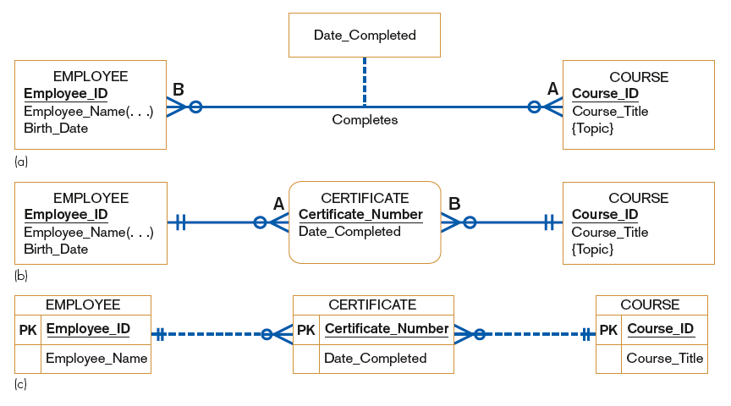
FIGURE 8-15 An associative entity
Attribute on a relationship
An associative entity (CERTIFICATE)
An associative entity using Microsoft Visio®

Slide 44
Summary of Conceptual Data Modeling with E-R Diagrams
The purpose of E-R diagramming is to capture the richest possible understanding of the meaning of the data necessary for an information system or organization.

Slide 45
Representing Super-types and Subtypes
Subtype: a subgrouping of the entities in an entity type
Is meaningful to the organization
Shares common attributes or relationships distinct from other subgroupings
Super-type: a generic entity type that has a relationship with one or more subtypes

Slide 46
Representing Super-types and Subtypes (Cont.)
Business Rules for Super-type/subtype Relationships:
Total specialization specifies that each entity instance of the super-type must be a member of some subtype in the relationship.
Partial specialization specifies that an entity instance of the super-type does not have to belong to any subtype, and may or may not be an instance of one of the subtypes.

Slide 47
Representing Super-types and Subtypes (Cont.)
Disjoint rule specifies that if an entity instance of the super-type is a member of one subtype, it cannot simultaneously be a member of any other subtype.
Overlap rule specifies that an entity instance can simultaneously be a member of two (or more) subtypes.

Slide 48
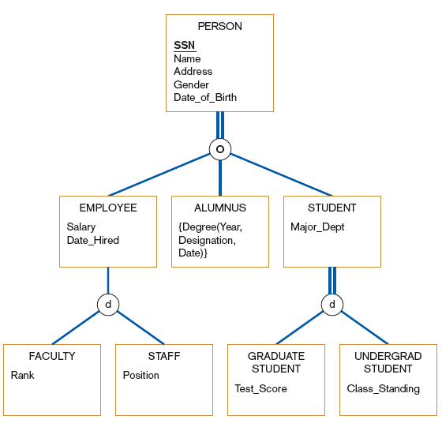
FIGURE 8-19
Example of supertype/subtype hierarchy

Slide 49
Business Rules
Business rules: specifications that preserve the integrity of the logical data model
Captured during requirements determination
Stored in CASE repository as they are documented

Slide 50
Business Rules (Cont.)
Four basic types of business rules are:
Entity integrity: unique, non-null identifiers
Referential integrity constraints: rules governing relationships between entity types
Domains: constraints on valid values for attributes
Triggering operations: other business rules that protect the validity of attribute values

Slide 51
Domains
Domain: the set of all data types and values that an attribute can assume
Several advantages
Verify that the values for an attribute are valid
Ensure that various data manipulation operations are logical
Help conserve effort in describing attribute characteristics

Slide 52
Triggering Operations
Trigger: an assertion or rule that governs the validity of data manipulation operations such as insert, update and delete

Slide 53
Triggering Operations
Includes the following components:
User rule: statement of the business rule to be enforced by the trigger
Event: data manipulation operation that initiates the operation
Entity Name: name of entity being accessed or modified
Condition: condition that causes the operation to be triggered
Action: action taken when the operation is triggered

Slide 54
Role of Packaged Conceptual Data Models – Database Patterns
Packaged data models provide generic models that can be customized for a particular organization’s business rules.
Universal data models are templates for
one or more core subject areas such as:
Customers, products, accounts, documents
and/or core business functions such as:
Purchasing, accounting, receiving, etc.

Slide 55
Role of Packaged Conceptual Data Models – Database Patterns (Cont.)
Industry-specific data models are designed to be used by organizations within specific industries.
These models are based on the premise that data model patterns for organizations are similar within a particular industry.

Slide 56
Benefits of Database Patterns and Packaged Data Models
Dramatically reduced implementation times and costs
Provides a starting point for asking requirements questions
Higher-quality models
Represent “best practice” data modeling techniques and data model components whose quality often exceeds that which can be achieved by internal development teams, given typical organizational pressures

Slide 57
Electronic Commerce Application: Conceptual Data Modeling
Five general categories of information were identified for Pine Valley Furniture’s WebStore.
Next step was to define each item.
The final step was to identify the interrelationships between the four entities.

Slide 58
Summary
In this chapter you learned how to:
Concisely define each of the following key data modeling terms: entity type, attribute, multivalued attribute, relationship, degree, cardinality, business rule, associative entity, trigger, super-type, subtype.
Draw an entity-relationship (E-R) diagram to represent common business situations.
Explain the role of conceptual data modeling in the overall analysis and design of an information system.

Slide 59
Summary (Cont.)
In this chapter you learned how to:
Explain the role of prepackaged database models (patterns) in data modeling.
Distinguish between unary, binary, and ternary relationships and give an example of each.
Define four basic types of business rules in a conceptual data model.
Relate data modeling to process and logic modeling as different views of describing an information system.

Slide 60
Designing Databases
References - - - - - - - - Valacich and George, Modern Systems Analysis and Design, 8th Ed., Pearson, Chapter 9

Slide 61
Learning Objectives
Concisely define each of the following key database design terms: relation, primary key, normalization, functional dependency, foreign key, referential integrity, field, data type, null value, de-normalization, file organization, index, and secondary key.
Explain the role of designing databases in the analysis and design of an information system.
Transform an entity-relationship (E-R) diagram into an equivalent set of well-structured (normalized) relations.

Slide 62
Learning Objectives (Cont.)
Merge normalized relations from separate user views into a consolidated set of well-structured relations.
Choose storage formats for fields in database tables.
Translate well-structured relations into efficient database tables.
Explain when to use different types of file organizations to store computer files.
Describe the purpose of indexes and the important considerations in selecting attributes to be indexed.

Slide 63
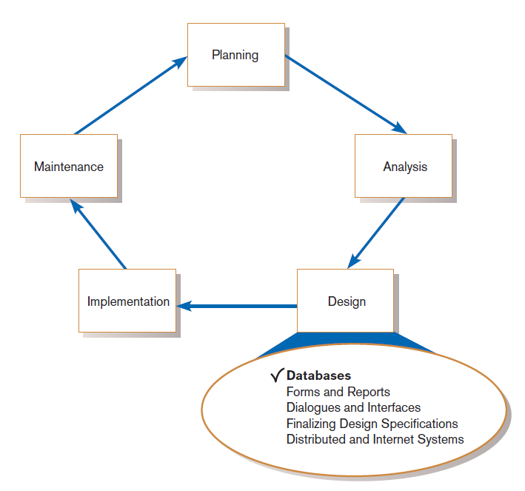
Introduction
FIGURE 9-1
Systems development life cycle with design phase highlighted

Slide 64
Database Design
File and database design occurs in two steps.
Develop a logical database model, which describes data using notation that corresponds to a data organization used by a database management system.
Relational database model
Prescribe the technical specifications for computer files and databases in which to store the data.
Physical database design provides specifications
Logical and physical database design in parallel with other system design steps

Slide 65
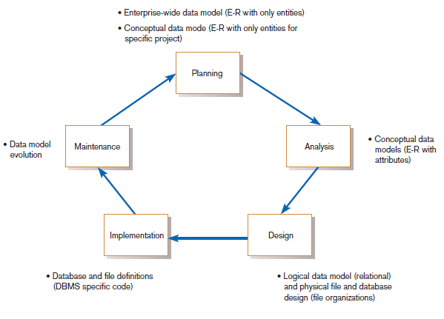
The Process of Database Design
FIGURE 9-2
Relationship between data modeling and the systems development life cycle

Slide 66
The Process of Database Design (Cont.)
Four key steps in logical database modeling and design:
Develop a logical data model for each known user interface for the application using normalization principles.
Combine normalized data requirements from all user interfaces into one consolidated logical database model (view integration).
Translate the conceptual E-R data model for the application into normalized data requirements.
Compare the consolidated logical database design with the translated E-R model and produce one final logical database model for the application.

Slide 67
Physical Database Design
Key physical database design decisions include:
Choosing a storage format for each attribute from the logical database model.
Grouping attributes from the logical database model into physical records.
Arranging related records in secondary memory (hard disks and magnetic tapes) so that records can be stored, retrieved and updated rapidly.
Selecting media and structures for storing data to make access more efficient.

Slide 68
Deliverables and Outcomes
Logical database design
Must account for every data element on a system input or output
Normalized relations are the primary deliverable.
Physical database design
Converts relations into database tables
Programmers and database analysts code the definitions of the database.
Written in Structured Query Language (SQL)

Slide 69
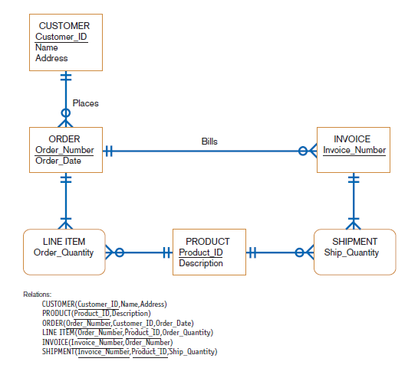
FIGURE 9-3 (d)
Conceptual data model and transformed relations

Slide 70
Relational Database Model
Relational database model: data represented as a set of related tables or relations
Relation: a named, two-dimensional table of data; each relation consists of a set of named columns and an arbitrary number of unnamed rows

Slide 71
Relational Database Model (Cont.)
Relations have several properties that distinguish them from non-relational tables:
Entries in cells are simple.
Entries in columns are from the same set of values.
Each row is unique.
The sequence of columns can be interchanged without changing the meaning or use of the relation.
The rows may be interchanged or stored in any sequence.

Slide 72
Well-Structured Relation and Primary Keys
Well-Structured Relation (or table)
A relation that contains a minimum amount of redundancy
Allows users to insert, modify, and delete the rows without errors or inconsistencies
Primary Key
An attribute whose value is unique across all occurrences of a relation
All relations have a primary key.
This is how rows are ensured to be unique.
A primary key may involve a single attribute or be composed of multiple attributes.

Slide 73
Normalization and Rules of Normalization
Normalization: the process of converting complex data structures into simple, stable data structures
The result of normalization is that every non-primary key attribute depends upon the whole primary key.

Slide 74
Normalization and Rules of Normalization (Cont.)
First Normal Form (1NF)
Unique rows, no multivalued attributes
All relations are in 1NF
Second Normal Form (2NF)
Each non-primary key attribute is identified by the whole key (called full functional dependency)
Third Normal Form (3NF)
Non-primary key attributes do not depend on each other (i.e. no transitive dependencies)

Slide 75
Functional Dependencies and Primary Keys
Functional Dependency: a particular relationship between two attributes
For a given relation, attribute B is functionally dependent on attribute A if, for every valid value of A, that value of A uniquely determines the value of B.
The functional dependence of B on A is represented by A→B.

Slide 76
Functional Dependencies and Primary Keys (Cont.)
Functional dependency is not a mathematical dependency.
Instances (or sample data) in a relation do not prove the existence of a functional dependency.
Knowledge of problem domain is most reliable method for identifying functional dependency.

Slide 77
Second Normal Form (2NF)
A relation is in second normal form (2NF) if any of the following conditions apply:
The primary key consists of only one attribute.
No non-primary key attributes exist in the relation.
Every non-primary key attribute is functionally dependent on the full set of primary key attributes.
To convert a relation into 2NF, decompose the relation into new relations using the attributes, called determinants, that determine other attributes.
The determinants are the primary keys of the new relations.

Slide 78
Third Normal Form (3NF)
A relation is in third normal form (3NF) if it is in second normal form (2NF) and there are no functional (transitive) dependencies between two (or more) non-primary key attributes.

Slide 79
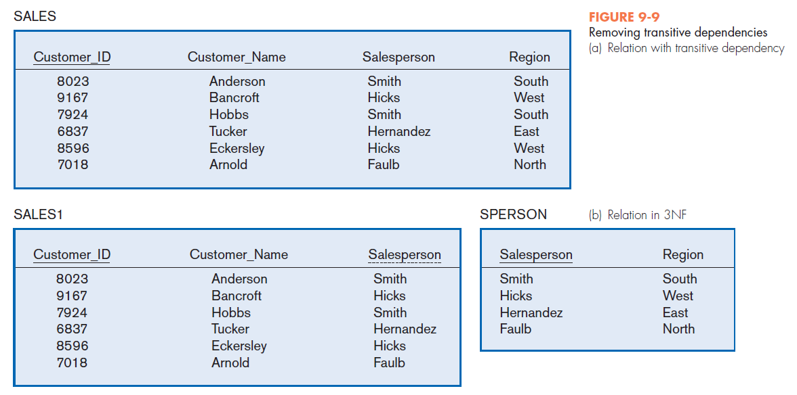

Slide 80
Third Normal Form (3NF) (Cont.)
Foreign Key: an attribute that appears as a non-primary key attribute in one relation and as a primary key attribute (or part of a primary key) in another relation
Referential Integrity: an integrity constraint specifying that the value (or existence) of an attribute in one relation depends on the value (or existence) of the same attribute in another relation

Slide 81
Transforming E-R Diagrams into Relations
It is useful to transform the conceptual data model into a set of normalized relations.
Steps
Represent entities.
Represent relationships.
Normalize the relations.
Merge the relations.

Slide 82
Representing Entities
Each regular entity is transformed into a relation.
The identifier of the entity type becomes the primary key of the corresponding relation.

Slide 83
Representing Entities
The primary key must satisfy the following two conditions.
The value of the key must uniquely identify every row in the relation.
The key should be non-redundant.
The entity type label is translated into a relation name.

Slide 84
Binary 1:N and 1:1Relationships
The procedure for representing relationships depends on both the degree of the relationship—unary, binary, ternary—and the cardinalities of the relationship.
Binary 1:N Relationship is represented by adding the primary key attribute (or attributes) of the entity on the one side of the relationship as a foreign key in the relation that is on the many side of the relationship.

Slide 85
Binary 1:N and 1:1Relationships (Cont.)
Binary or Unary 1:1 Relationship is represented by any of the following choices:
Add the primary key of A as a foreign key of B.
Add the primary key of B as a foreign key of A.
Both of the above

Slide 86
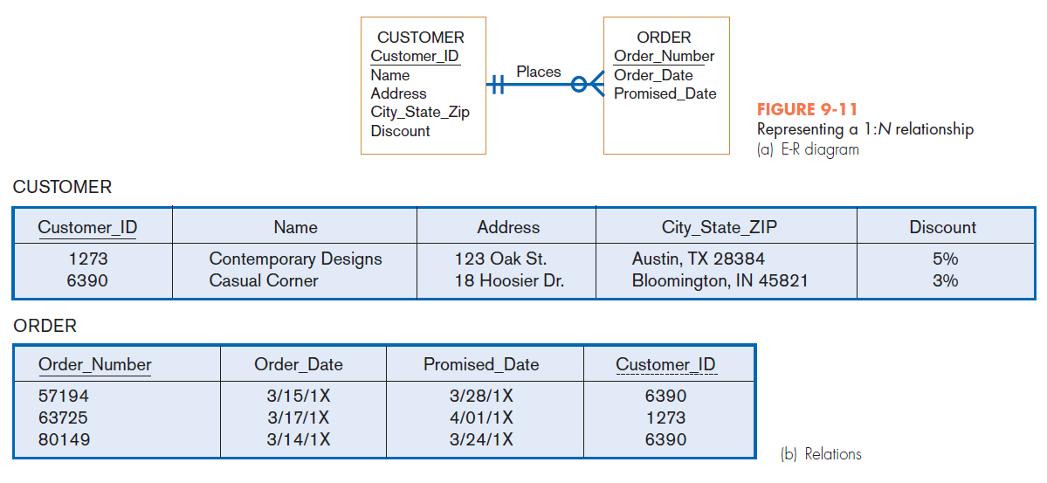

Slide 87
Binary and Higher-Degree M:N Relationships
Create another relation and include primary keys of all relations as primary key of new relation

Slide 88
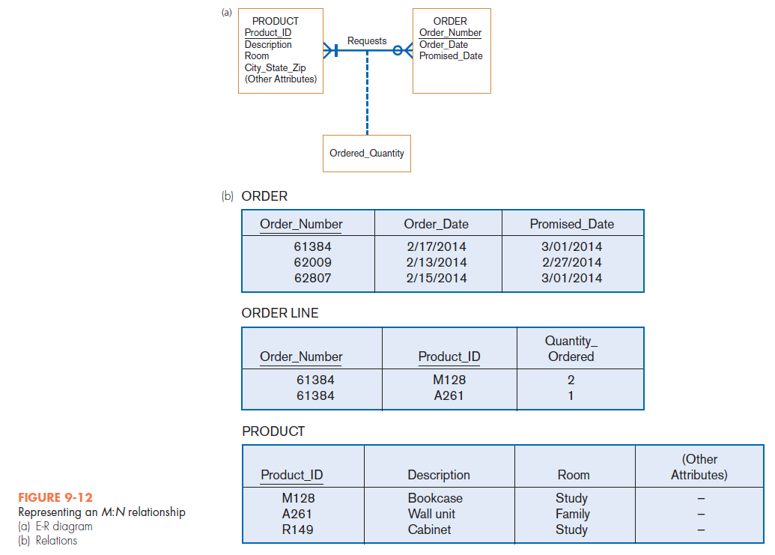

Slide 89
Unary Relationships
Unary 1:N Relationship
Is modeled as a relation
Primary key of that relation is the same as for the entity type
Foreign key is added to the relation that references the primary key values
Recursive foreign key: a foreign key in a relation that references the primary key values of that same relation

Slide 90
Unary Relationships
Unary M:N Relationship
Model as one relation, then
Create a separate relation to represent the M:N relationship.
The primary key of the new relation is a composite key of two attributes that both take their values from the same primary key.
Any attribute associated with the relationship is included as a non-key attribute in this new relation.

Slide 91
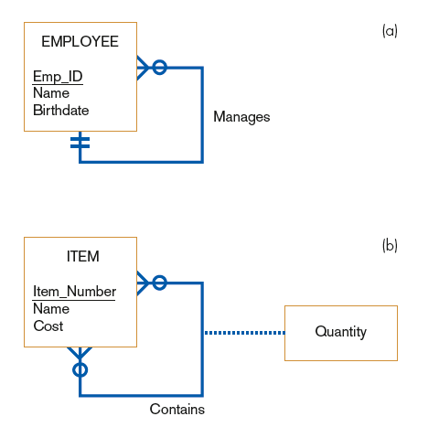

FIGURE 9-13
Two unary relationships
(a) EMPLOYEE with Manages
relationship (1:N)
(b) Bill-of-materials
structure (M:N)

Slide 92
Merging Relations
Purpose is to remove redundant relations
The last step in logical database design
Prior to physical file and database design

Slide 93
View Integration Problems
Must understand the meaning of the data and be prepared to resolve any problems that arise in the process
Synonyms: two different names used for the same attribute
When merging, get agreement from users on a single, standard name.

Slide 94
View Integration Problems (Cont.)
Homonyms: a single attribute name that is used for two or more different attributes.
Resolved by creating a new name
Dependencies between non-keys— dependencies may be created as a result of view integration
To resolve, the new relation must be normalized

Slide 95
View Integration Problems (Cont.)
Class/Subclass — relationships may be hidden in user views or relations
Resolved by creating a new name

Slide 96
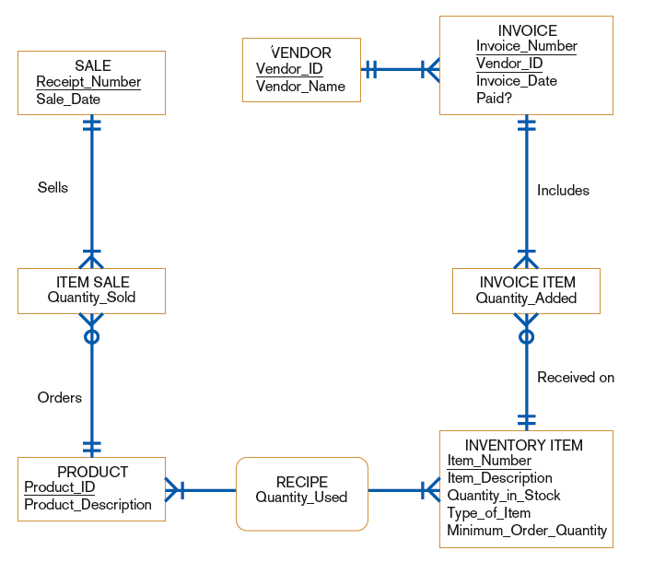
FIGURE 9-16
Class diagram corresponding to normalized relations of Hoosier Burger‘s inventory control system

Slide 97

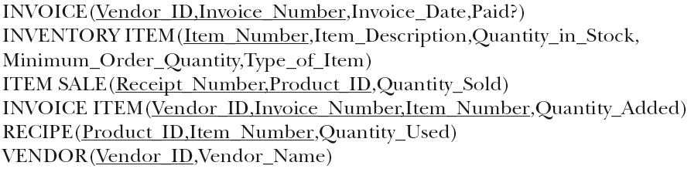
Relations for Hoosier Burger

Slide 98
Physical File and Database Design
The following information is required:
Normalized relations, including volume estimates
Definitions of each attribute
Descriptions of where and when data are used, entered, retrieved, deleted, and updated (including frequencies)
Expectations or requirements for response time and data integrity
Descriptions of the technologies used for implementing the files and database

Slide 99
Designing Fields
Field: the smallest unit of named application data recognized by system software
Attributes from relations will be represented as fields
Data Type: a coding scheme recognized by system software for representing organizational data

Slide 100
Choosing Data Types
Selecting a data type balances four objectives:
Minimize storage space.
Represent all possible values of the field.
Improve data integrity of the field.
Support all data manipulations desired on the field.

Slide 101
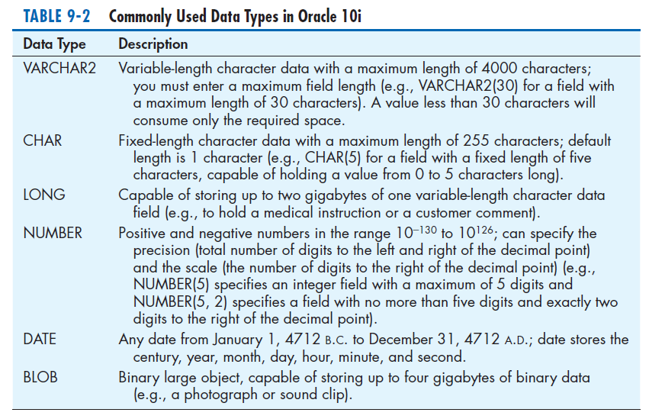

Slide 102
Calculated Fields
Calculated (or computed or derived) field: a field that can be derived from other database fields
It is common for an attribute to be mathematically related to other data.
The calculate value is either stored or computed when it is requested.

Slide 103
Controlling Data Integrity
Default Value: a value a field will assume unless an explicit value is entered for that field
Range Control: limits range of values that can be entered into field
Both numeric and alphanumeric data
Referential Integrity: an integrity constraint specifying that the value (or existence) of an attribute in one relation depends on the value (or existence) of the same attribute in another relation
Null Value: a special field value, distinct from zero, blank, or any other value, that indicates that the value for the field is missing or otherwise unknown

Slide 104
Designing Physical Tables
Relational database is a set of related tables.
Physical Table: a named set of rows and columns that specifies the fields in each row of the table
De-normalization: the process of splitting or combining normalized relations into physical tables based on affinity of use of rows and fields
De-normalization optimizes certain data processing activities at the expense of others.

Slide 105
Designing Physical Tables (Cont.)
Three types of table partitioning:
Range partitioning: partitions are defined by nonoverlapping ranges of values for a specified attribute
Hash partitioning: a table row is assigned to a partition by an algorithm and then maps the specified attribute value to a partition
Composite partitioning: combines range and hash partitioning by first segregating data by ranges on the designated attribute, and then within each of these partitions

Slide 106
Designing Physical Tables (Cont.)
Various forms of de-normalization, which involves combining data from several normalized tables, can be done.
No hard-and-fast rules for deciding
Three common situations where de-normalization may be used:
Two entities with a one-to-one relationship
A many-to-many relationship (associative entity) with non-key attributes
Reference data

Slide 107
File Organizations
File organization: a technique for physically arranging the records of a file
Physical file: a named set of table rows stored in a contiguous section of secondary memory

Slide 108
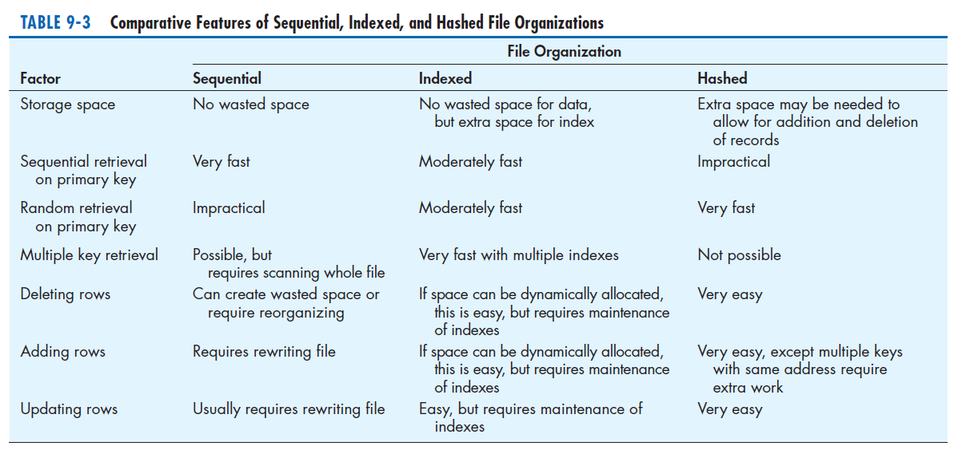
FILE ORGANIZATIONS (CONTD.)

Slide 109
File Organizations (Cont.)
Sequential file organization: a file organization in which rows in a file are stored in sequence according to a primary key value
Hashed file organization: a file organization in which the address for each row is determined using an algorithm
Pointer: a field of data that can be used to locate a related field or row of data

Slide 110
Arranging Table Rows
Objectives for choosing file organization
Fast data retrieval
High throughput for processing transactions
Efficient use of storage space
Protection from failures or data loss
Minimizing need for reorganization
Accommodating growth
Security from unauthorized use

Slide 111
Indexed File Organization
Indexed file organization: a file organization in which rows are stored either sequentially or non-sequentially, and an index is created that allows software to locate individual rows
Index: a table used to determine the location of rows in a file that satisfy some condition
Secondary keys: one or a combination of fields for which more than one row may have the same combination of values

Slide 112
Indexed File Organization (Cont.)
Main disadvantages:
Extra space required to store the indexes
Extra time necessary to access and maintain indexes
Main advantage:
Allows for both random and sequential processing
Guidelines for choosing indexes
Specify a unique index for the primary key of each table.
Specify an index for foreign keys.
Specify an index for non-key fields that are referenced in qualification, sorting and grouping commands for the purpose of retrieving data.

Slide 113
Designing Controls for Files
Two of the goals of physical table design are protection from failure or data loss and security from unauthorized use.
These goals are achieved primarily by implementing controls on each file.
Two other important types of controls address file backup and security.

Slide 114
Designing Controls for Files (Cont.)
Techniques for file restoration include:
Periodically making a backup copy of a file.
Storing a copy of each change to a file in a transaction log or audit trail.
Storing a copy of each row before or after it is changed.
Means of building data security into a file include:
Coding, or encrypting, the data in the file.
Requiring data file users to identify themselves by entering user names and passwords.
Prohibiting users from directly manipulating any data in the file by forcing users to work with a copy (real or virtual).

Slide 115
Physical Database Design for Hoosier Burger
The following decisions need to be made:
Decide to create one or more fields for each attribute and determine a data type for each field.
For each field, decide if it is calculated; needs to be coded or compressed; must have a default value or picture; or must have range, referential integrity, or null value controls.
For each relation, decide if it should be denormalized to achieve desired processing efficiencies.
Choose a file organization for each physical file.
Select suitable controls for each file and the database.

Slide 116
Electronic Commerce Application: Designing Databases
Designing databases for Pine Valley Furniture’s WebStore
Review the conceptual model (E-R diagram).
Examine the lists of attributes for each entity.
Complete the database design.
Share all design information with project team to be turned into a working database during implementation.

Slide 117
Summary
In this chapter you learned how to:
Concisely define each of the following key database design terms: relation, primary key, normalization, functional dependency, foreign key, referential integrity, field, data type, null value, de-normalization, file organization, index, and secondary key.
Explain the role of designing databases in the analysis and design of an information system.
Transform an entity-relationship (E-R) diagram into an equivalent set of well-structured (normalized) relations.

Slide 118
Summary (Cont.)
Merge normalized relations from separate user views into a consolidated set of well-structured relations.
Choose storage formats for fields in database tables.
Translate well-structured relations into efficient database tables.
Explain when to use different types of file organizations to store computer files.
Describe the purpose of indexes and the important considerations in selecting attributes to be indexed.

